Slide 1
Low Power Protocol and Application Design (I)
Week 13

Slide 2
Outline
Low power technologies of network protocols and networked applications
  MAC/LLC layers
  TCP/IP layers
  Application layers
Power management and power control: cases study
  Cellular protocols
  WLAN protocols
  Bluetooth protocols

Slide 3
Basics of Power Control and Management
Let's start from scratch
  Power
    P(watt) = I (A) x V (V)
  For example,
    Battery, 3.6V, 1000mAh
    Speech mode
      300 mA
      Talking time : 1000mAh/300 mA=200 mins
      Power consumption : 300mA x 3.6V=1.080W
    Sleep mode
      10 mA
      Standby time : 1000mAh/10 mA=100 hrs
      Power consumption : 10mA x 3.6V = 36mW

Slide 4
Basics of Power Control and Management (Cont.)
Characteristics of Power Consumption
  GSM mobile phone
    Sleep mode : 10mW-100mW
    Speech mode : 0.5W-1.5W
  GSM module (without LCD)
    Sleep mode : ~ 10mW
    Speech mode : 0.5W - 1W
  Battery
    500mAh-5000mAh
    Material, capacity, and weight
    Ni-Cd, Ni-MH, Li
    1000mAh Li battery weight about 50g (including packaging)
  GSM mobile
    Standby time : 50-250 hrs
    Talk time : 2 hrs – 5 hrs

Slide 5
Basics of Power Control and Management (Cont.)
Characteristics of Power Consumption
  WLAN
    801.11b PCMCIA
      Standby mode : ~150mW
      Rx mode : ~1W
      Tx mode : ~2W
  Bluetooth
    Standby mode : 50 uW – 300 uW
    Rx/Tx mode : 50mW~100 mW

Slide 6
Basics of Power Control and Management (Cont.)
Characteristics of Power Consumption
  PDA (iPAQ)
    Battery 1250 mAh
    w/o WLAN/GSM/BT
      Idle Mode (screen active with no user Input or Output) : 100mAh (500mW/12 hours)
      Active Mode, Backlight off (frequent user input) 120 mAh (600mW/10 hours)
    w/ WLAN
      Idle Mode, WLAN receive only : 400mAh (2W/3 hours)
  How about a device with WLAN/GSM/BT/DAB/3G ?
    Battery issues

Slide 7
Basics of Power Control and Management (Cont.)
Distribution of Power Consumption
  GSM (Nokia 8210)
    Idle mode
      IC Chips : 50mW
      LCD : 30mW (w/o backlight)
      LCD : 100mW (w/ backlight)
    Speech mode
      All PAs + IC Chips : 1W
      LCD : 30mW/100mW (w and w/o backlight)
      Ring : 200mW-500mW
      Vibration : 200mW

Slide 8
Basics of Power Control and Management (Cont.)
Power Control
  To control the transmission/receiving power of a mobile device/a base station
Power Management
  To manage the level of power consumption(operational states) of a mobile devices/a base station

Slide 9
Low power technologies of network protocols and networked applications

Slide 10
Introduction
Personal Communication System (PCS) is the future.
  Wireless device is anywhere at any time
Battery life of mobile terminals is limited
  Energy efficiency is important
Focus on low-power design of the entire network protocol stack

Slide 11
Introduction (con’t)
Significant consumers of power in typical laptop
  CPU
  LCD
  HD
  DRAM
  Wireless network interface
  K/B,mouse
  CDROM
  Floppy
  I/O

Slide 12
Introduction (con’t)
Example : Toshiba 410 CDT mobile computer
  LCD…………………36%
  CPU/Memory………..21 %
  Wireless interface……18%
  H/D…………………..18%
  Other

Slide 13
Background
Wireless network architecture
  Infrastructure
    Centric topology
    Mobile terminals + base station (AP)
  Ad hoc
    Distributed topology
    Temporary network connectivity, military environment
    Features:
      Dynamic, un-predictable, random, multi-hop topology

Slide 14
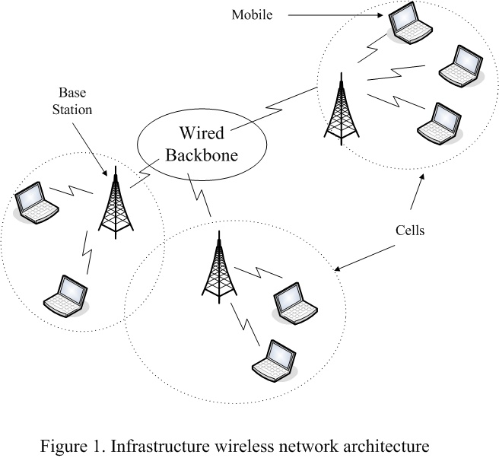
Background (con’t)
Infrastructure

Slide 15
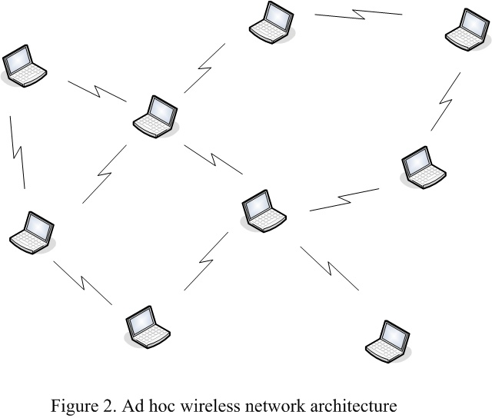
Background (con’t)
Ad hoc

Slide 16
Background (con’t)
Protocol stack
Protocol | Data unit | function
Physical | Bit (signal) | RF, modulation, channel coding
Data link | Frame | Link error control, security , packet retransmission LLC : media access control
Network | Packet | Routing packet, TOS
Transport | Segment | Reliable data transport
AP-OS/middleware | Data | Disconnection, adaptivity support, Power and QoS management
AP-application | data

Slide 17
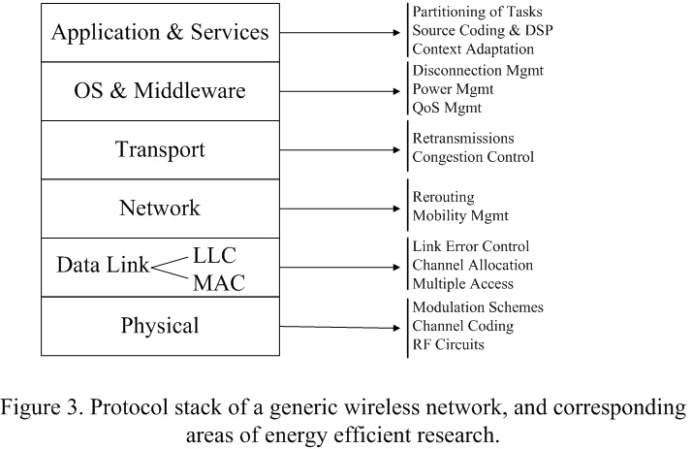
Background (con’t)
Protocol stack

Slide 18
Efficient methods
(protocols approach)
Physical layer
  Low-power design at the hardware layer
    Variable clock speed CPU
    Flash memory
    Disk spin-down

Slide 19
Efficient methods
(protocols approach) (con’t)
Higher level layer concept
  Source of power consumption
    Communication
      Transmit
      Receive
      standby
    Computation
      CPU and memory is used in protocol stack processing
  Communication increasing make computation decreasing, and vice versus.
 | PCMCIA- Proxim Rage LAN | PCMCIA- Lucent
Tx | 1.5W | 1.82W
Rx | 0.75W | 1.8W
St. | 0.01W | 0.18W

Slide 20
Efficient methods
(protocols approach) (con’t)
Data link layer
  MAC layer
    Collisions and retransmission
    broadcast environment follow IEEE 802.11
    Rx-Tx mode switching
    distributed scheduling algorithm
  Link layer
    Automatic repeat request (ARQ) and forward error correction (FEC)
Network layer
  All nodes equally deplete their battery power

Slide 21
Efficient methods
(protocols approach) (con’t)
OS layer
  Power-aware CPU scheduling
  Page allocation
App Layer
  Database access with power efficiency → mobile database system
  Video processing with power efficiency → mobile streaming system
  Software strategies for energy efficiency

Slide 22
Efficient methods
(protocols approach) (con’t)
Data link layer (MAC)
  Collisions and retransmission
    Collision should be eliminated
    Retransmission
      Unnecessary power consumption
      Possibly unbounded delay
  Improvement – EC-MAC[2000, ref. 53]
      Small packet size for registration
      Bandwidth request

Slide 23
Efficient methods
(protocols approach) (con’t)
Data link layer (MAC)
  broadcast environment follow IEEE 802.11
    Receiver remains on at all times
    Power consumption!!
  Improvement
    Standby : EC-MAC (infrastructure)[2000,ref. 53]
    Turnoff transciever : PAMAS (ad hoc) [1998,ref.51]

Slide 24
Efficient methods
(protocols approach) (con’t)
Data link layer (MAC)
  Rx-Tx mode switching is power comsuption
  Improvement
    Buffering writes (minimize seek latency)[1999 ref. 13]
      Contiguous allocation
      Aggregation packet request

Slide 25
Efficient methods
(protocols approach) (con’t)
Data link layer (MAC)
  distributed scheduling algorithm
    Each mobile computer schedule independently
  Improvement
    Mobile-based adaptive algorithms [1999 2000,ref.14 ref.15]
    Energy efficiency and channel error compensation

Slide 26
Efficient methods
(protocols approach) (con’t)
Data link layer (Link Layer )
  Automatic repeat request (ARQ) and forward error correction (FEC) are power consumption
  Improvement
    Combine ARQ & FEC [1997,ref.32]
    Tradeoff :
      retransmission with ARQ vs longer packets with FEC

Slide 27
Efficient methods
(protocols approach) (con’t)
Network layer
  All nodes equally deplete their battery power
  Improvement
    The periodicity of routing update [1997 2000, ref.52 ref.66] →inefficiency when user mobility is high
    ? Topology is controlled by varying the Tx power of nodes [2000,ref.49]

Slide 28
Efficient methods
(protocols approach) (con’t)
OS level
  Power-aware CPU scheduling [1997 1994,ref.36 ref.65]
  Page allocation [2000,ref.31]
Application level
  Database access with power efficiency[1993 1994, ref.3 ref.24]
  Video processing with power efficiency[1998 1995 1996, ref.1 ref.10 ref.21]
  Software strategies for energy efficiency [1998,ref.37]

